Slide 1
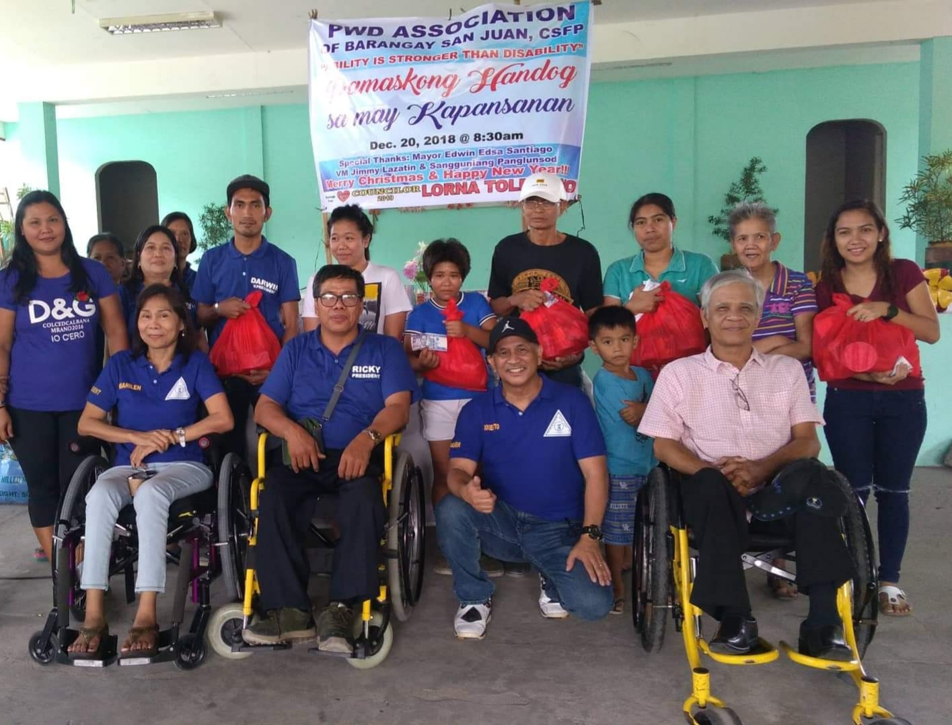

What is
PWD Welfare
Society Inc.

Slide 2


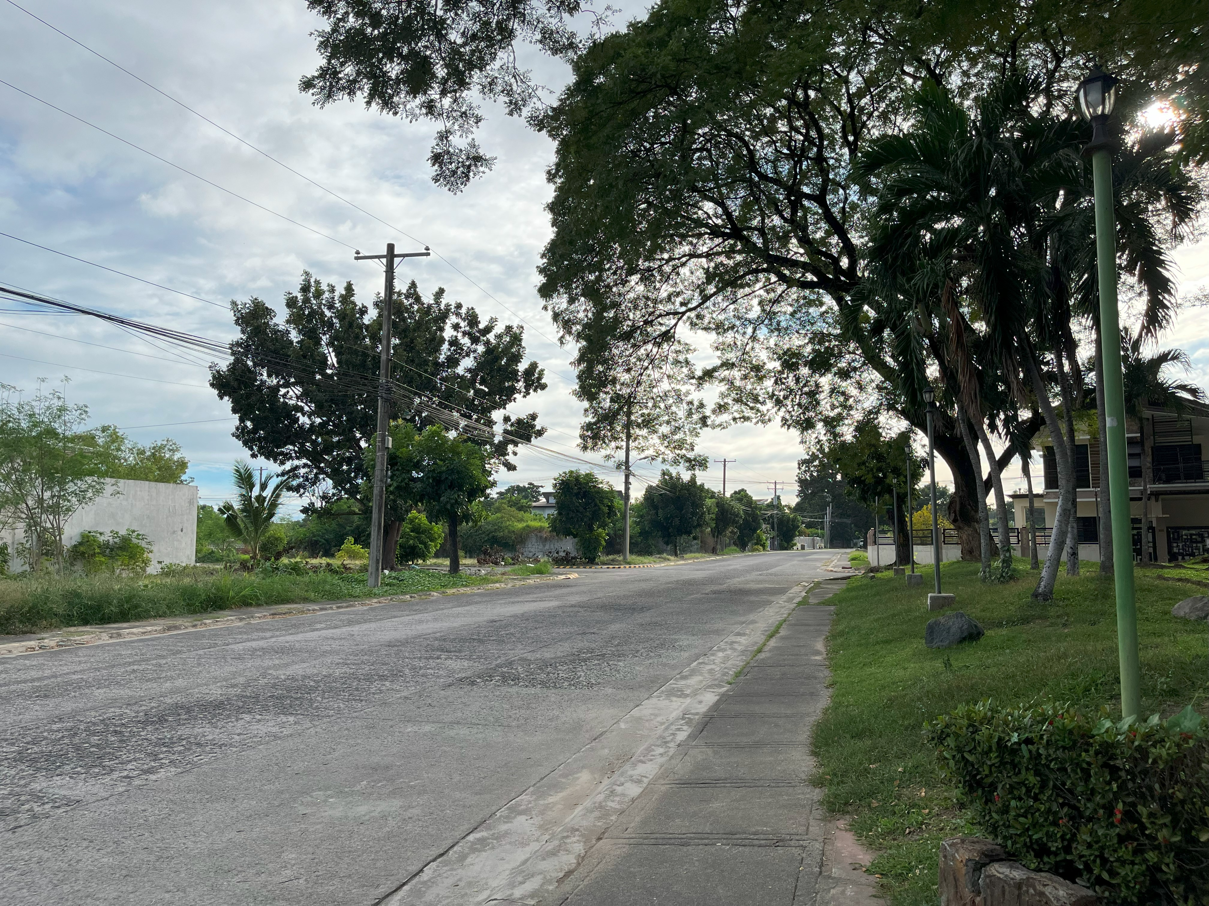

Why
What is
PWD Welfare
Barangay Malpitic
Society Inc.
www.suburbianorh.website
Why
SUBURBIA
NORTH

Slide 3
WireFrame & Mockup
What is
Why
PWD Welfare
Society Inc.
www.suburbianorh.website

Slide 4
What is
WireFrame & Mockup
PWD Welfare
Society Inc.
www.suburbianorh.website

